Slide 1

JavaScript Array
arrays

Slide 2
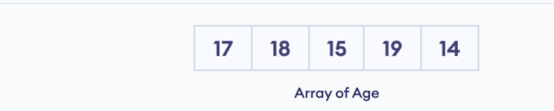
Introduction
An array is an object that can store multiple values at once.
Suppose we need to record the age of 5 students. Instead of creating 5 separate variables, we can simply create an array:
Notes:
// empty array const emptyArray = []; // array of strings const actions = [ 'eat', 'work', 'sleep’]; // array with mixed data types const mixedArray = ['work', 1, true];

Slide 3

Create array
We can create an array by placing elements inside an array literal [], separated by commas. For example,
Here,
numbers - name of the array
[10, 30, 40, 60, 80] - elements of the array
Notes:
// empty array const emptyArray = []; // array of strings const actions = [ 'eat', 'work', 'sleep’]; // array with mixed data types const mixedArray = ['work', 1, true];

Slide 4
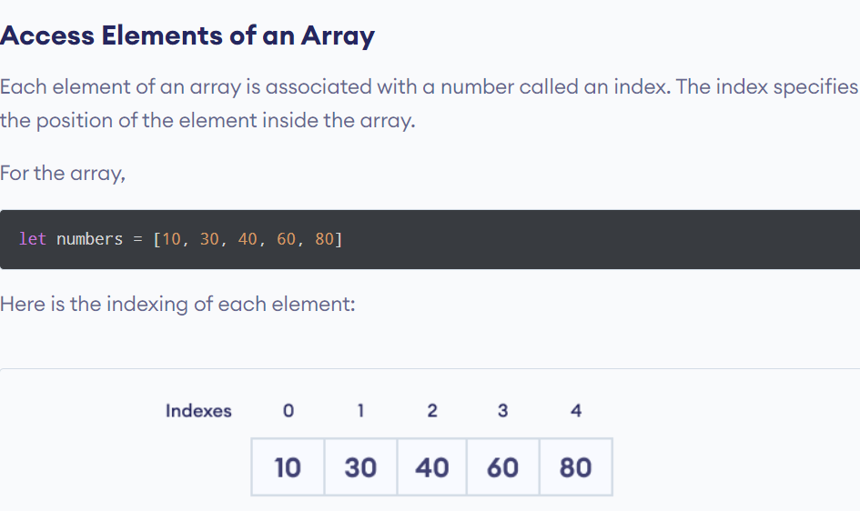
Notes:
let numbers = [10, 30, 40, 60, 80]
// access first element
console.log(numbers[0]);
// access third element
console.log(numbers[2]);

Slide 5
Add Element to an Array
We can add elements to an array using built-in methods like push() and unshift().
The push() method adds an element at the end of the array.
Notes:
let dailyActivities = ['eat', 'sleep’]; // add an element at the end dailyActivities.push('exercise’); console.log(dailyActivities);

Slide 6
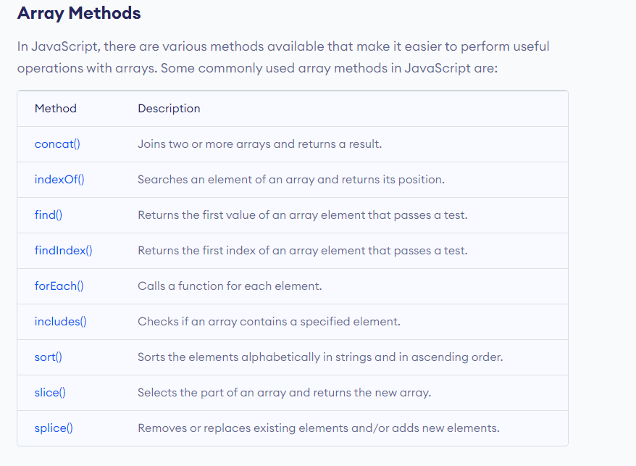
Notes:
let dailyActivities = ['eat', 'sleep’]; // add an element at the end dailyActivities.push('exercise’); console.log(dailyActivities);

